Slide 1

Welcome to Children’s Rally

Slide 2

Welcome to Children’s Rally

Slide 3
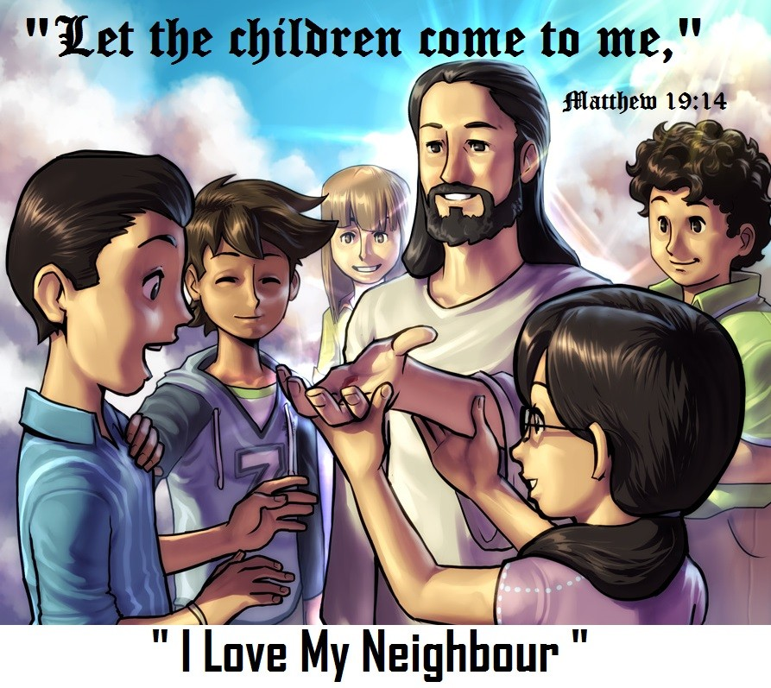
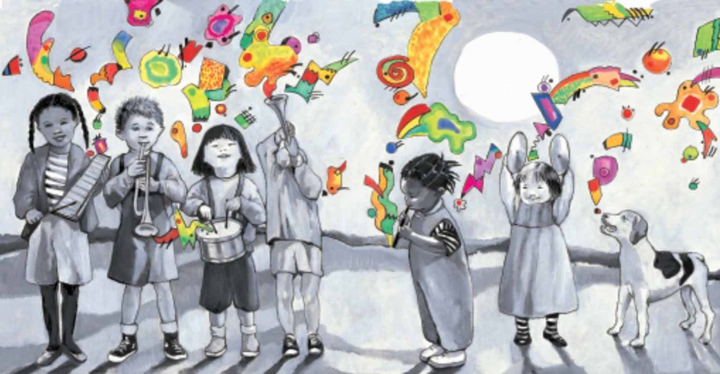
GAMES

Slide 4
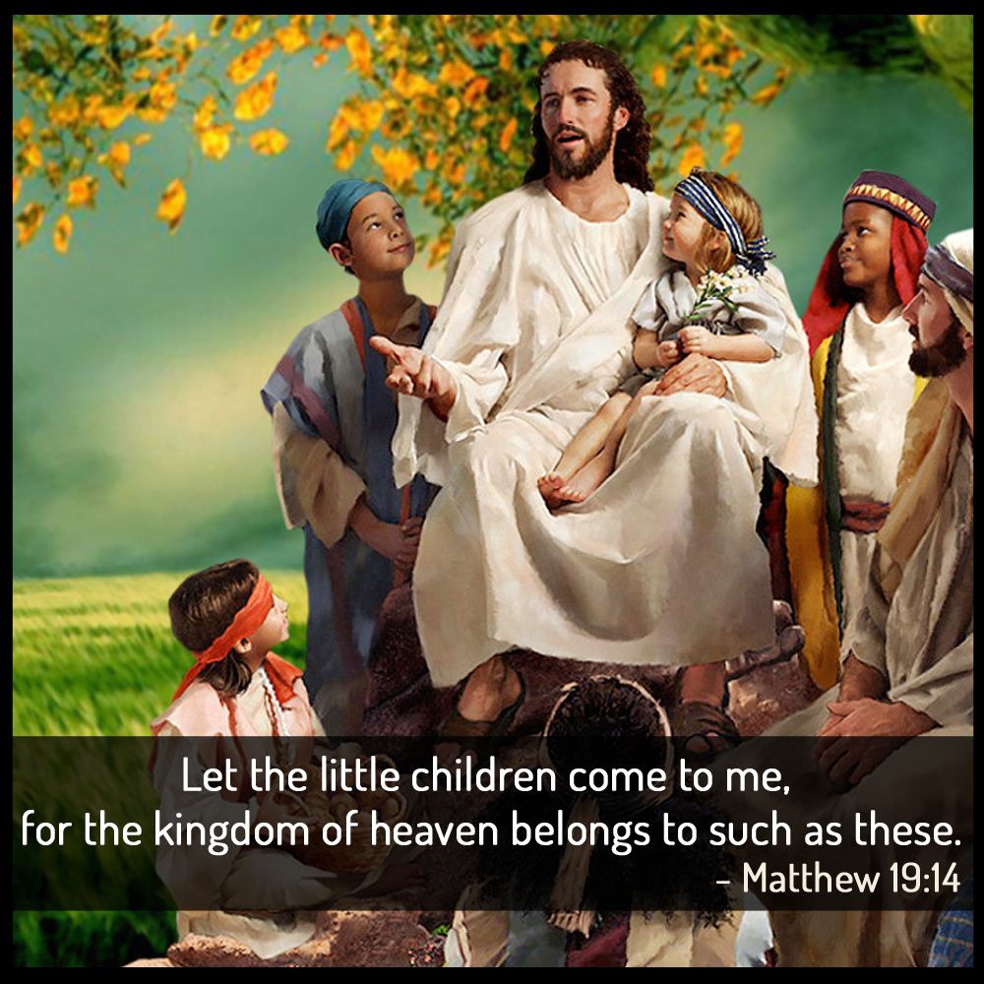
CLASS SECTION

Slide 5

SKIT

Slide 6
Ml;Lf;Fl;lp ehd; Ml;Lf;Fl;lp
Ml;Lf;Fl;lp ehd; Ml;Lf;Fl;lp
,NaRtpd; ke;ij Ml;Lf;Fl;lp
Gy;Ys;s ,lq;fspy; Nka;j;jpLthh;
mkh;e;j jz;zPuz;il elj;jpLthh;
Mlp ghLNtd; mfkfpo;Ntd;
Js;sp Js;sp Js;sp Js;sp
mth; gpd; nry;Ntd;

Slide 7

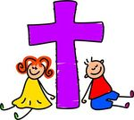
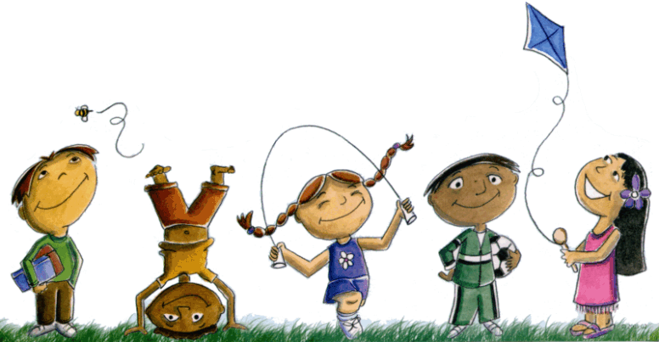
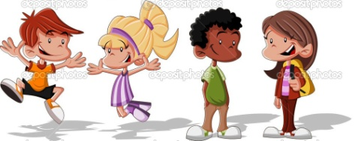
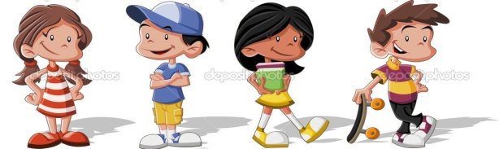
mayhiu Nerpg;Ngd;
mayhiu Nerpg;Ngd;
mayhiu Nerpg;Ngd;
mayhiu Nerpg;Ngd;
,NaR vd;id Nerpj;jjhy;

Slide 8
I love my neighbour
I love my neighbour
I love my neighbour
I love my neighbour
For Jesus loved me so

Slide 9
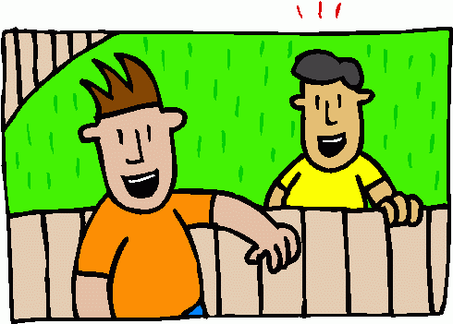
mz;Nz nfhQ;rk; epy;Y
mz;Nz nfhQ;rk; epy;Y
Wrong route m nfhQ;rk; khj;J
mf;fh nfhQ;rk; epy;Y
Wrong route m nfhQ;rk; khj;J
vy;yhiuAk; md;G nra;a
fj;Jf;fDk; ePAk; - 2
ePAk; Mkh ehDk; Mkh
ePAk; Mkh ehDk; - 2

Slide 10
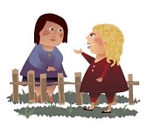
mz;Nz nfhQ;rk; epy;Y
,NaR rhkp ghU
mtU vd;d nrhd;dhU NfS – 2
vy;yhiuAk; xU jha;
gps;isapdhU
vy;iy fle;J vy;yhiuAk;
Nerpf;f nrhd;dhU
nrhd;dhU nrhd;dhU
nrhd;dhU nrhd;dhU - 2

Slide 11
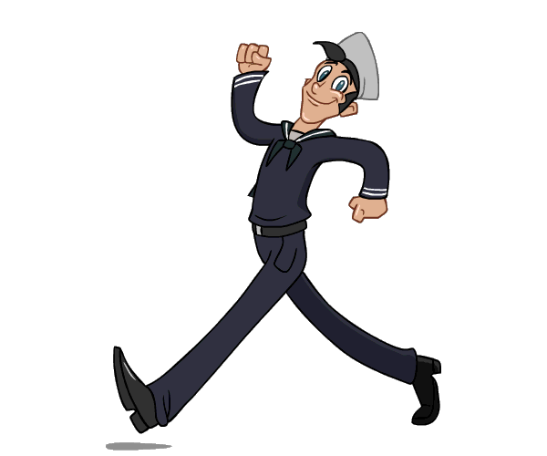
Your walk talks
Your walk talks,
your talk talks
your walk talks louder
than your talk talks - 2

Slide 12
Your walk talks
Walk not in darkness
as children of the night
Walk even as Jesus walked,
Walk as the children of light

